Slide 1


An Adaptive Modulation For Free Space Optical (FSO) Systems
Review-I
AY 2025-26
Capstone Project – Introduction (PROJ2999)
GITAM (Deemed-to-be) University
Department of Electrical Electronics and Communication Engineering
Project Team:
Hari Pawar
Saiprajwalreddy
Laxmiprasad Sindageri
Project Mentor:
Rohan Prasad
Project In-charge:
Dr.Subhashish Tiwari
www.gitam.edu

Slide 2
Objective and Goals
Objective
Develop an adaptive modulation for Free Space Optical Systems.
To implement M Pulse Position Modulation (M-PPM) for FSO systems to improve power efficiency.
To integrate turbo coding for error correction and reliable data transmission.
To develop an adaptive modulation scheme that dynamically adjusts modulation size based on Channel State Information (CSI).
To compare adaptive vs non-adaptive FSO systems in terms of Bit Error Rate (BER), outage probability, and bandwidth efficiency.
Goals
Main Goals
To model and simulate a Free-Space Optical (FSO) communication channel in MATLAB
Develop an adaptive modulation algorithm that selects optimal modulation size based on real-time Channel State Information (CSI).
Evaluate performance metrics like Bit Error Rate (BER), bandwidth efficiency, and outage probability for adaptive vs non-adaptive systems.
Additional Goals
To evaluate outage probability under different weather conditions

Slide 3
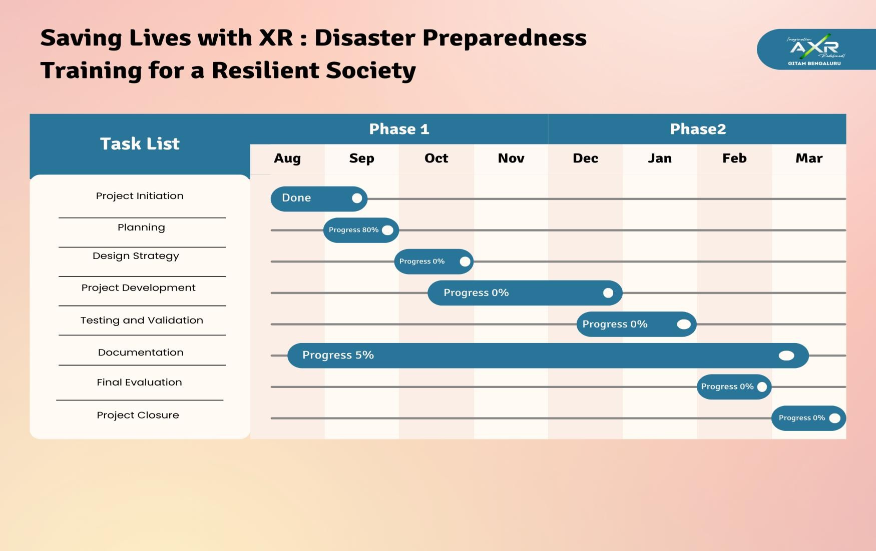
Project Plan

Slide 4
Literature Survey
Key Publications
1)Adaptive Coded Modulation for IM/DD Free-Space Optical Backhauling.
Author: Ahmed Elzanaty and Mohamed-Slim Alouini.
Journal:Google Scholar
Key Takeaways: The paper proposes SpaDCoM, which uses probabilistic shaping (CCDM) + binary FEC to transmit a mix of shaped (sparse) and uniform (dense) symbols over FSO links. This design adapts to turbulence, works close to channel capacity (within 0.2 dB), saves power, and remains practical with standard FEC codes.
2) Adaptive Subcarrier PSK Intensity Modulation in Free-Space Optical Systems
Author: Nestor D. Chatzidiamantis, Athanasios S. Lioumpas, George K. Karagiannidis, Shlomi Arnon.
Journal:Google Scholar
Key Takeaways: This paper shows that Adaptive S-PSK Intensity Modulation allows FSO links to change modulation order depending on turbulence, improving spectral efficiency and reliability while keeping BER under control. It works best in moderate-to-strong turbulence and can be further enhanced with MIMO apertures.
3)Power Control and Adaptive Digital Pulse Interval Modulation for Free Space Optical Links.
Author: Mohammad Taghi Dabiri, Mohammad Javad Saber, and Seyed Mohammad Sajad Sadough
Journal:Google Scholar
Key Takeaways:The proposed technique uses Power Control combined with an Adaptive Digital Pulse Interval Modulation (DPIM) scheme to significantly mitigate the performance degradation caused by atmospheric turbulence (like scintillation and fading) in Free Space Optical (FSO) links, thereby achieving more reliable and efficient communication.

Slide 5
Literature Survey
4)Performance analysis of an adaptive optics system for free-space optics communication through atmospheric turbulence.
Author: Yukun Wang, Huanyu Xu, Dayu Li, Rui Wang, Chengbin Jin, Xianghui Yin, Shijie Gao, Quanquan Mu, Li Xuan & Zhaoliang Cao
Journal:Google Scholar
Key Takeaways: This paper demonstrates that adaptive optics, if properly designed can dramatically improve the reliability and performance of free-space optical links under turbulence.
5)Adaptive Modulation for FSO IM/DD Systems With Multiple Transmitters and Receivers
Author: Hatef Nouri, Sadiq M. Sait, and Murat Uysal .
Journal:Google Scholar
Key Takeaways: This 2023 paper proposes adaptive modulation for multi-aperture IM/DD FSO systems, achieving much higher spectral efficiency and reliability compared to non-adaptive or single-aperture systems, particularly in turbulent channels.
6) Adaptive Coded Modulation for FSO Links
Author: K. Fatima, S. Sheikh Muhammad and Erich Leitgeb
Journal:Google Scholar
Key Takeaways: This 2012 paper shows that adaptive coded modulation (ACM) using PAM/PPM + LDPC improves FSO links by dynamically adjusting to weather/turbulence, achieving both high throughput in good channels and strong reliability in adverse ones.

Slide 6
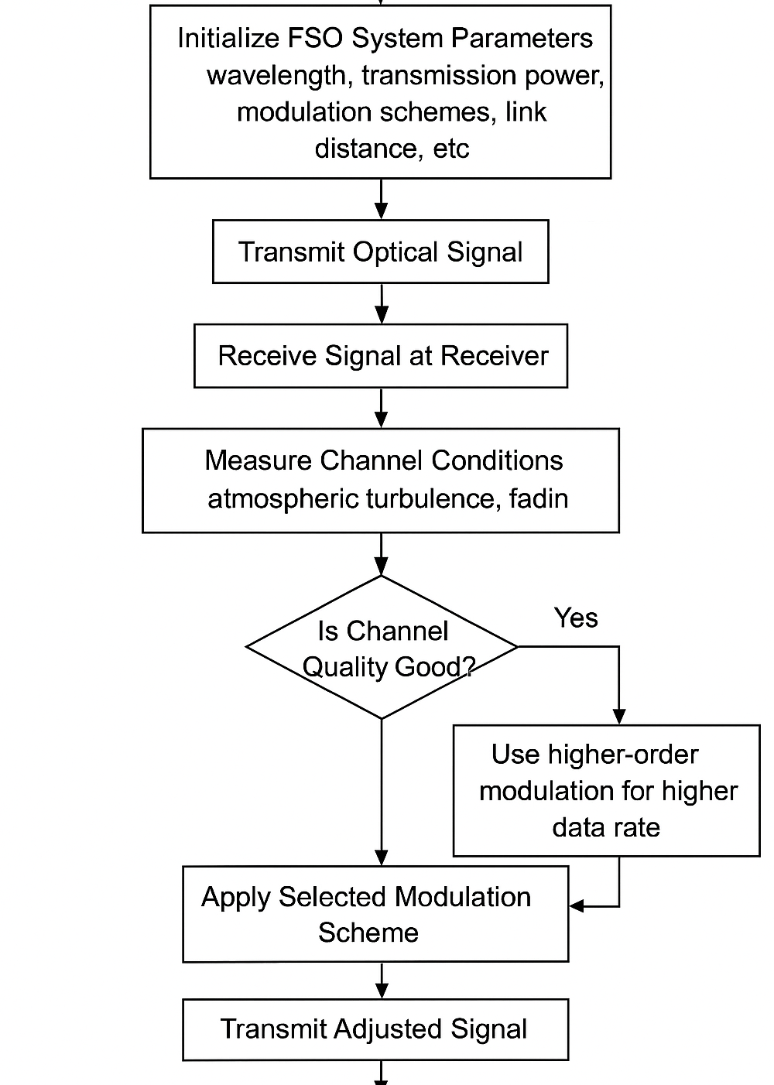
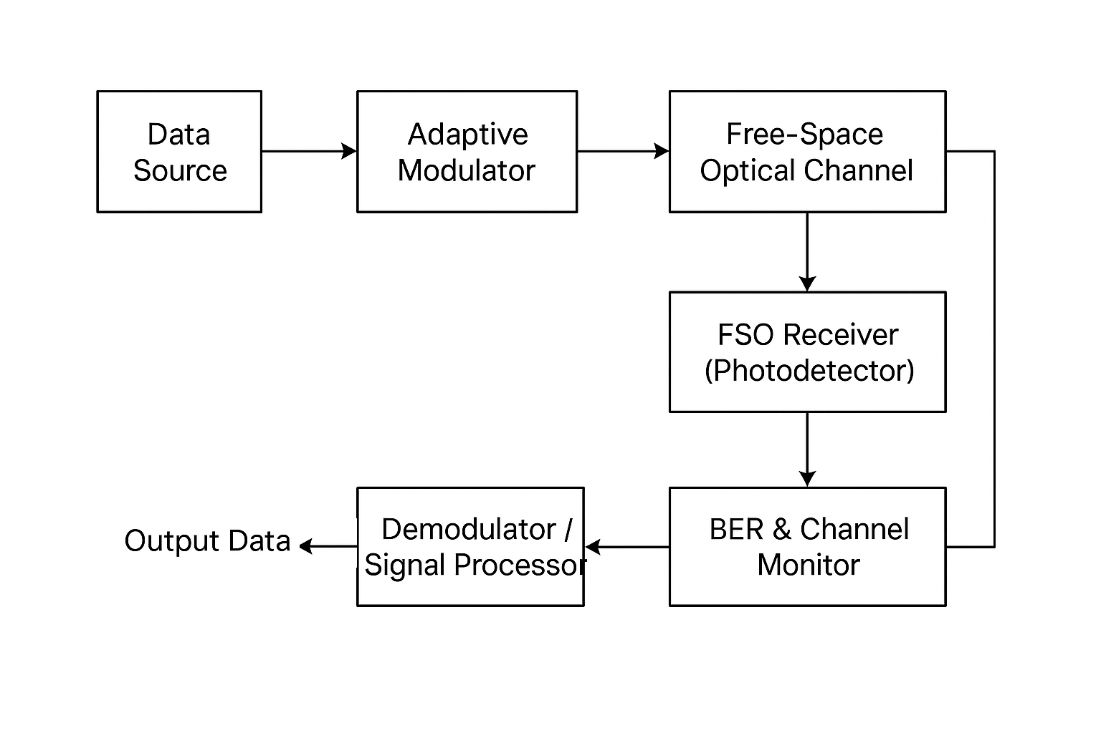
Architecture
Structural Diagram
Block Diagram :
FLOW CHART:

Slide 7
Use Cases & Testing
Use Cases
LAN-to-LAN Connectivity : Adaptive modulation ensures stable throughput even under turbulence.
Optical Fiber Backup Links : Adaptive coding & modulation maintains service continuity during fiber cuts or degradation
Wireless Cellular Backhaul:Adaptive modulation helps maintain required bandwidth efficiency with lower transmit power.
Temporary Deployments:FSO with adaptive schemes ensures higher link robustness when rapid deployment is needed.
Test Cases
Atmospheric Turbulence Simulation : verify the adaptive algorithm selects M (M-PPM) under log-normal fading.
Peak Power Constraint: If more power is needed, system declares an outage instead of transmitting dangerously.
Bandwidth Efficiency Validation: Compare adaptive vs non-adaptive transmission. Adaptive scheme achieves the same efficiency using less power.
BER Threshold Performance:Adaptive scheme always meets the target with less power.

Slide 8
Implementation and Results – Iteration 1
Iteration 1 : Results

Slide 9
Implementation and Results – Iteration 2
Iteration : Results + Validation against the use cases and test cases

Slide 10
Implementation and Results – Iteration 3 (Optional)
Iteration : Results + Validation against the use cases and test cases

Slide 11
Conclusion & Future Work
Summary and Conclusion
In this project, we explored the use of adaptive modulation in Free-Space Optical (FSO) communication to address the challenges posed by atmospheric turbulence, signal fading, and varying channel conditions. The system was designed to dynamically adjust the modulation scheme—such as Pulse Position Modulation (PPM)—based on real-time channel quality, ensuring that the bit error rate (BER) remained within acceptable limits. Simulations demonstrated that adaptive modulation significantly improves link reliability and spectral efficiency compared to traditional fixed-modulation systems. The project highlights that by adapting the modulation in response to changing environmental conditions, FSO communication systems can achieve higher throughput, better quality of service, and more robust performance. Overall, the study confirms that adaptive modulation is a practical and effective approach for enhancing FSO link performance, making optical wireless communication more resilient and efficient for real-world applications.
Future Work
Integrate adaptive modulation with advanced error correction to reduce bit error rates under severe turbulence.
Compare adaptive vs non adaptive systems.
Optimize for energy efficiency to reduce power consumption while maintaining high data rates.

Slide 12
THANK YOU
Have a Great Day !

